Slide 1


Presented by Team WDID?
Challenge 2
Understand load
Forecasting Total Load and Load per Cluster
12.11. 2023

Slide 2
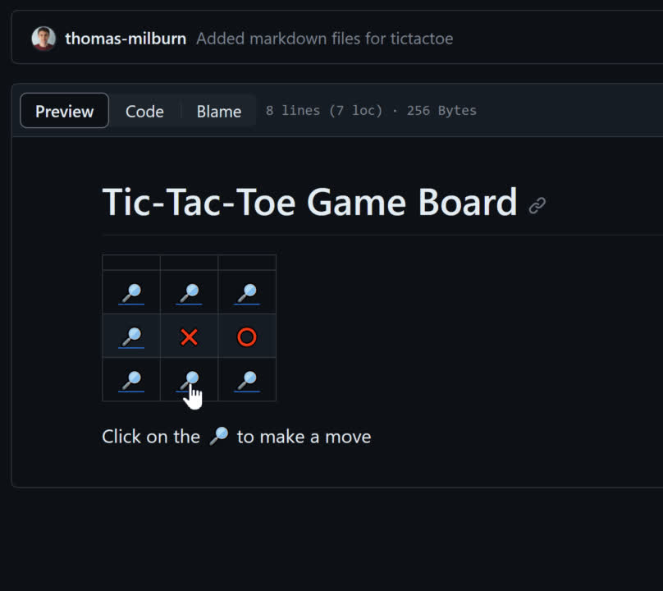
Introduction:
Hi! We are “What does it do?” and welcome to our solution proposed for the SolarZero Challenge 2. As it was our first Hackathon, we had for goal to have as much fun as possible while also learning as much as possible.
Our team is made up of four people:
Artur Wiktorowicz
Charuduth Bagha
Josh Haworth
Thomas Milburn
Hopefully you find our solution useful and our presentation entertaining!
As a side project, we also wanted to see how far we could push GitHub. We decided to create a game of TicTacToe that you can play against a computer, using mark down files and linking between the markdown files, all within GitHub

Slide 3

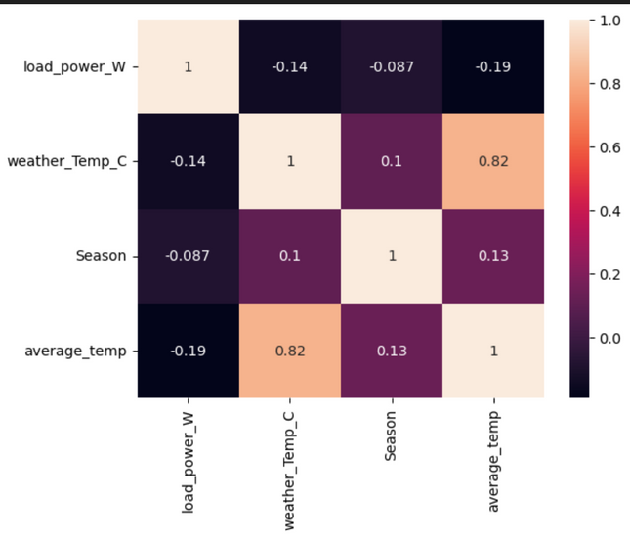
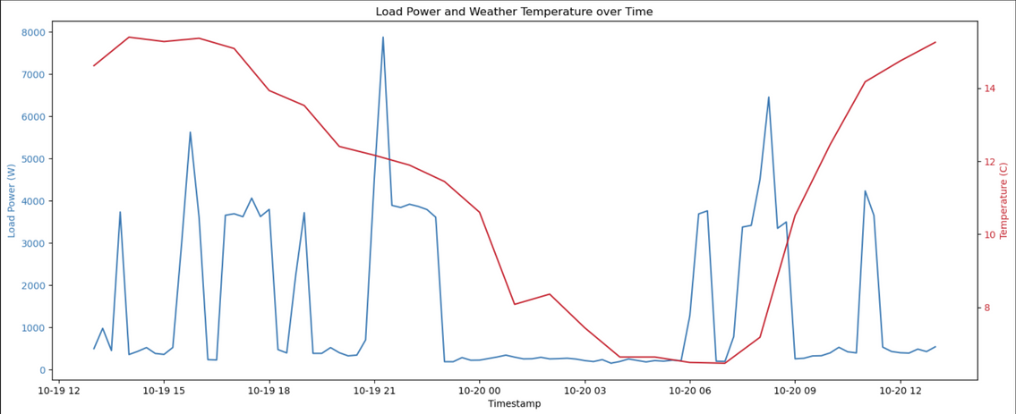
Implementation: 1
Our first step was to spot and remove any erroneous data, followed by sorting by customerID and date, time.
Some data that we thought were useful for detecting trends, patterns and create forecasts were:
Convert the date to New Zealand Timezone to use the times provided for predictions specific to NZ
Create seasons too for the same reason.
Create average daily temperature
We also plotted a graph of weather_temp and load_power to look for any correlations. We then created a heatmap to get a different correlation visualisation.
Correlation Plot
Correlation Heatmap

Slide 4
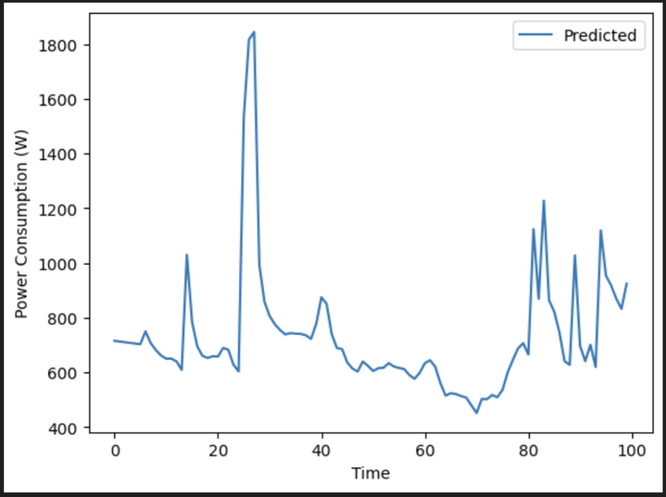
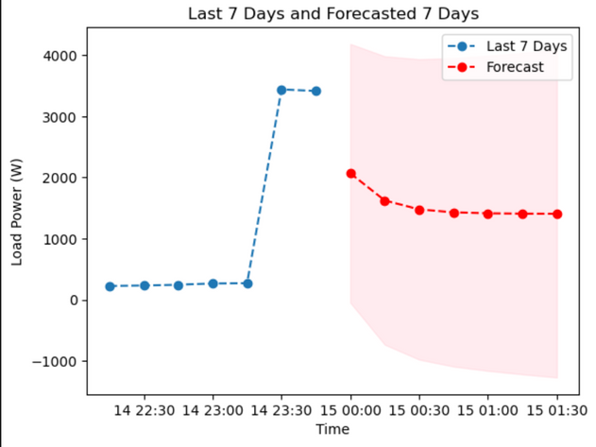
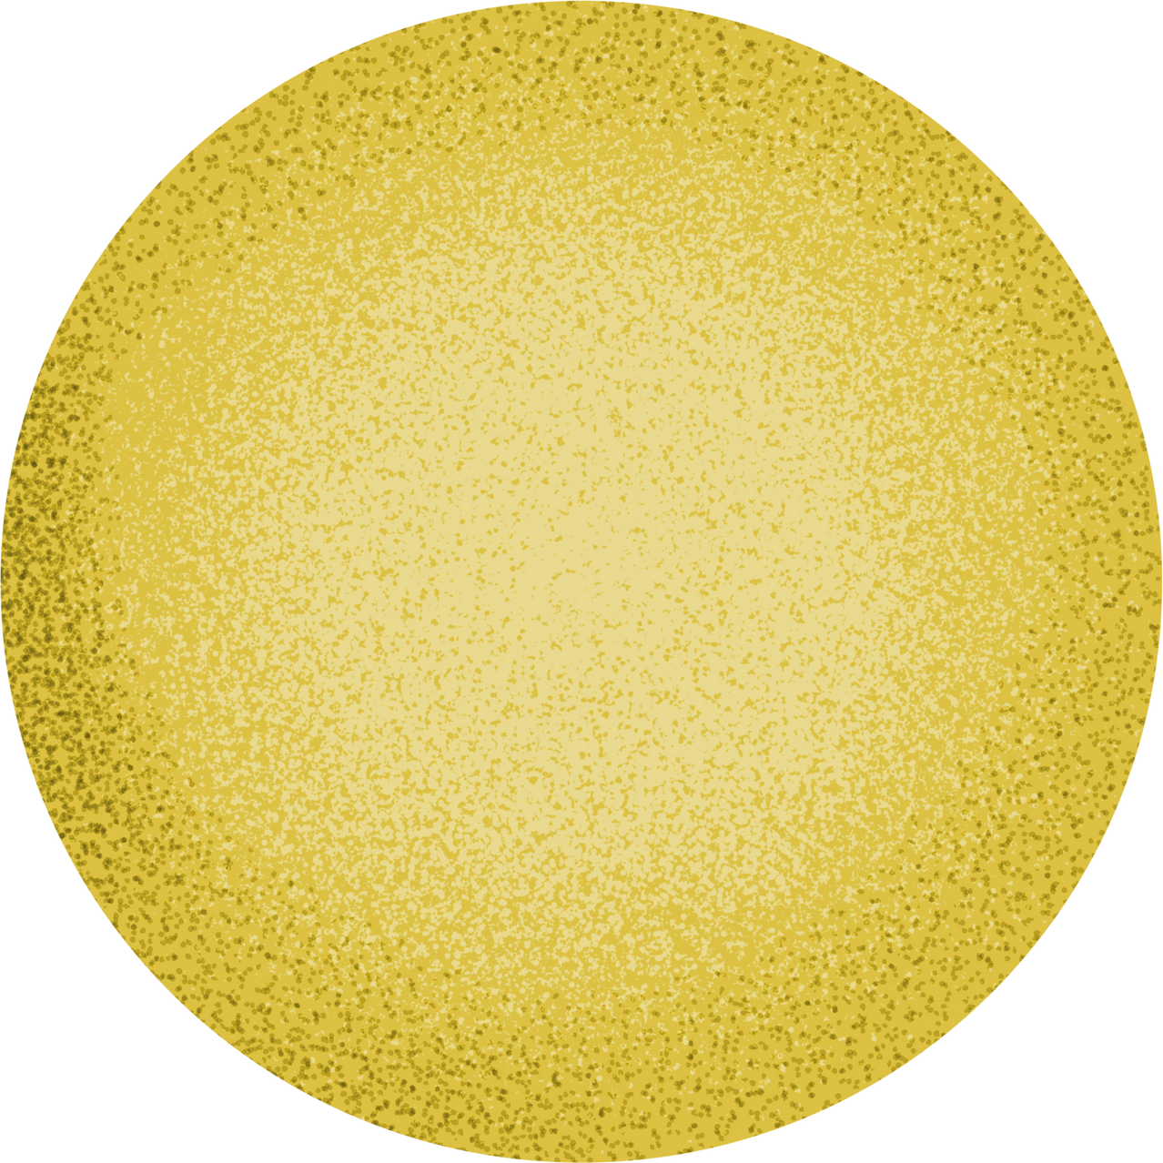
Implementation: 2
We started our first prediction model, LSTM by:
Smoothing the load_power v/s time graph,
It can capture long-term dependencies better than RNNs, which tend to forget the distant past inputs.
Our second predition model used ARIMA, where
we checked for stationarity
visualised our data using ACF and PACF plots
Predict the next 7 days using ARIMA
LSTM Forecast
ARIMA Forecast

Slide 5
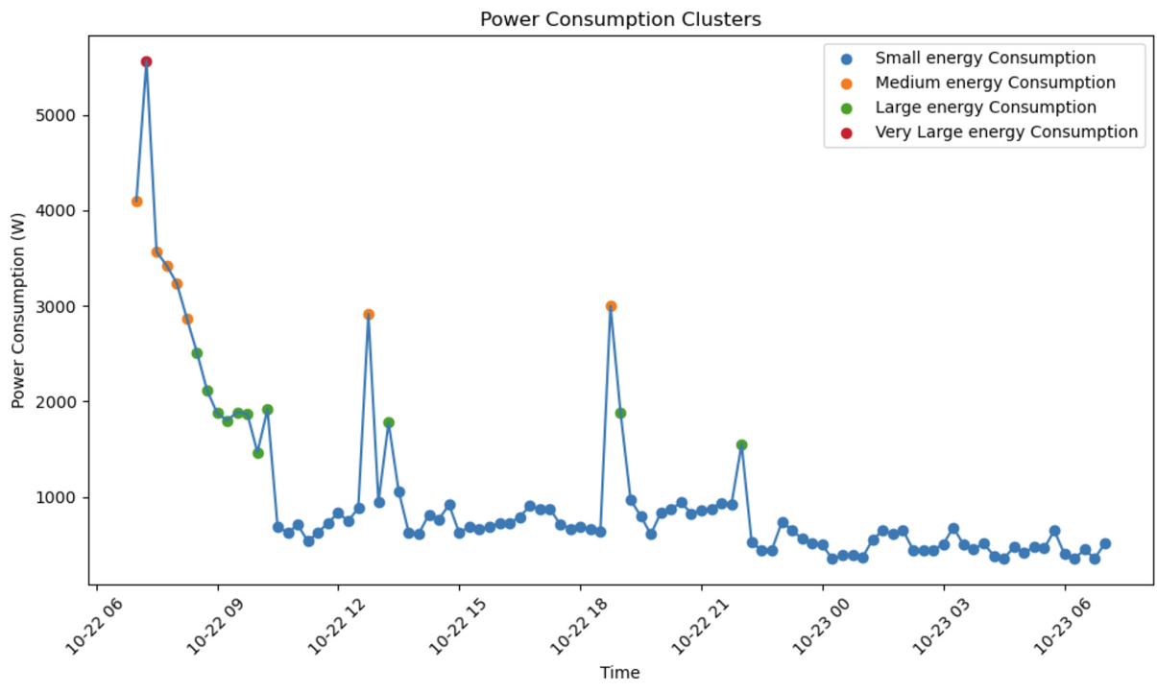
Appliances Identification
I chose to use k-means clustering for grouping energy consumptions because it is a versatile and efficient method for identifying distinct patterns in data. By applying k-means, I can partition energy consumption data into clusters based on similarity, enabling the identification of specific load profiles or usage patterns. This approach simplifies the analysis of diverse energy consumption behaviors and allows for a more granular understanding of customer loads, contributing to the accurate forecasting of total load and load per cluster.

Slide 6

Presented by Team WDID?
Thank you very much!
12.11.2023

